Slide 1

GOVERNMENT COLLEGE OF ENGINEERING, BARGUR
(Affiliated to Anna University, Accredited by NAAC with ‘B’ Grade)
PERFORMANCE COMPARISON OF RECOMMENDER SYSTEMS
PROJECT – I PRESENTATION
Under the guidance of Dr. S. Selvi PhD (Sr. Gr)
61072011130 - NITHISHKUMAR S
61072011125 - MAHAKASILINGAM A

Slide 2
ABSTRACT
The recommender systems are used in many product-based companies for profiling users based on the data that gets generated include personalized information and user interaction data.
The recommender system model implements four various algorithms for performance comparison.
The best recommendation algorithm is then chosen and is tested for appropriate user information.

Slide 3
MACHINE LEARNING
Machine learning is the field of study that gives computers the ability to learn without being explicitly programmed.
Supervised learning is use of labeled datasets to train algorithms that to classify data or predict outcomes accurately.
Regression is a technique for investigating the relationship between independent variables or features and a dependent variable or outcome.

Slide 4
CONTENT BASED FILTERING
Content-based filtering uses item features to recommend other items similar to what the user likes, based on their previous actions or explicit feedback.
The item on a dataset must have a discrete, identifiable and unique description.

Slide 5
COLLABORATIVE BASED FILTERING
Collaborative filtering is a family of algorithms where there are multiple ways to find similar users or items and multiple ways to calculate rating based on ratings of similar users.
More robust mathematical model is discovered and the collaborative filtering method is getting better every year.

Slide 6
HYBRID RECOMMENDER SYSTEM
Lack of information about the domain dependencies in collaborative filtering, and about the people's preferences in content-based system gave way to hybrid recommendation system
Hybrid recommendation systems are mix of content-based recommendation system and collaborative-based recommendation system.

Slide 7
EXISTING SYSTEM
They are plain, just facts about the result of the recommendation systems.
Does not know about how models train on data.
Complexity increases as the number of recommendation algorithms to compare increase.
Does not always yield good result.

Slide 8
PROPOSED SYSTEM
Deals with the details of how the data gets trained.
Results are interpreted in a nice form.
Give good comparison results even on different large and different datasets.

Slide 9
SOFTWARE libraries
Pandas – Data manipulation and analysis library
Numpy – Contains multidimensional array objects
SkLearn – For statistical modeling
NLTK – Used for Natural Language Processing

Slide 10
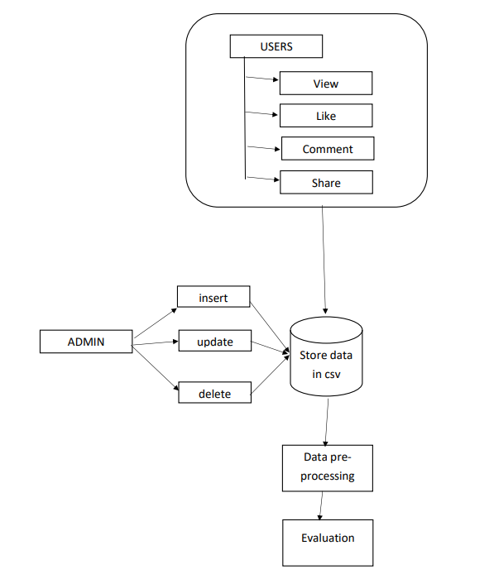
SYSTEM ARCHITECTURE

Slide 11
PROJECT MODULES
Data Pre - Processing
Training data
Evaluation
Performance comparison

Slide 12
DATA PREPROCESSING
Data pre-processing is a process of preparing the raw data and making it suitable for a machine learning model.
A real-world data generally contains noises, missing values, and maybe in an unusable format which cannot be directly used for machine learning models.

Slide 13
Training data
Training data is the data you use to train an algorithm or machine learning model to predict the outcome you design your model to predict.
In our project, we load the Deskdrop dataset, which contains a real sample of 12 months logs (Mar. 2016 - Feb. 2017) from CI&T's Internal Communication platform (DeskDrop).

Slide 14
Evaluation
Content based filtering uses vector space model which is defined as the model assumes that the relevance of a document to query is roughly equal to the document-query similarity.
Collaborative based filtering uses Matrix Factorization which compresses user-item matrix into a low-dimensional representation in terms of latent factors.
Popularity based filtering simply recommends to a user the most popular items that the user has not previously consumed.

Slide 15
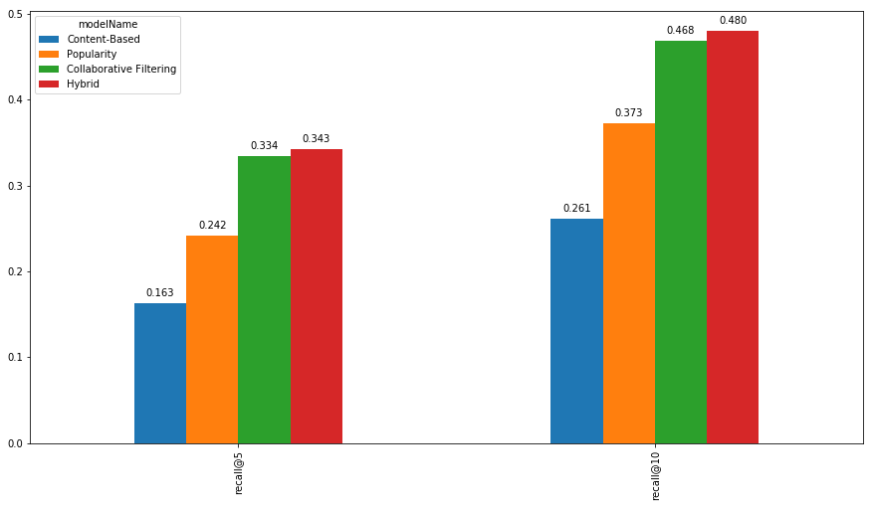
Performance comparison

Slide 16
conclusion
The number of internet user will grow rapidly in the upcoming years. Thus, the preference personalization becomes concern for many of the tech industries.
Thus, these proposed algorithms will be incorporated with more advanced backend services in the future.

Slide 17
Thank you

